Slide 1

Sentiment Analysis of Tweets with PySpark
Leveraging TF-IDF and Logistic Regression for Scalable Insights

Slide 2

Introduction
Unlocking the Emotion Behind Text
Sentiment analysis is a computational approach to identifying and categorizing opinions expressed in a piece of text, especially in customer reviews and social media. This presentation explores a practical application using PySpark to analyze a dataset of tweets labeled as either positive or negative, providing insights into public opinion at scale.

Slide 3
Methodology
Preprocessing Raw Data for Analysis
1. Data Loading & Selection
2. Label Conversion
Tweets are loaded from a CSV, focusing on the 'text' and 'sentiment' columns for relevant data extraction.
https://www.kaggle.com/datasets/kazanova/sentiment140?resource=download
Converting categorical sentiment labels ('positive', 'negative') into numerical format (1, 0) for machine learning compatibility.
3. Tokenization
4. Stopword Removal
Breaking down tweet text into individual words (tokens) to prepare for feature extraction.
Eliminating common words (e.g., 'the', 'is') that add little value to sentiment prediction, reducing noise and improving efficiency.

Slide 4




Implementation
Feature Engineering and Model Pipeline
TF (Term Frequency)
IDF (Inverse Document Frequency)
Calculates how often a word appears in a document, creating a vector representation for each tweet.
Weights down common words and scales up rare words, highlighting their importance across the dataset.
Logistic Regression
PySpark ML Pipeline
A classification algorithm applied to the TF-IDF features to predict the sentiment (positive/negative) of each tweet.
Combines these steps into an efficient, scalable workflow, automating the entire process from text to sentiment prediction.

Slide 5

Conclusion
Key Takeaways & Future Directions
Accurate Sentiment Prediction: The TF-IDF and Logistic Regression model effectively predicts tweet sentiment.
Efficiency and Scalability: PySpark enables the processing of large text datasets efficiently, demonstrating its power for big data NLP tasks.
Foundation for Advanced NLP: This approach provides a solid baseline for more complex sentiment analysis, capable of handling vast amounts of social media data.
Future improvements could explore deep learning models (e.g., LSTMs, Transformers) for enhanced accuracy and nuanced sentiment detection.

Slide 6
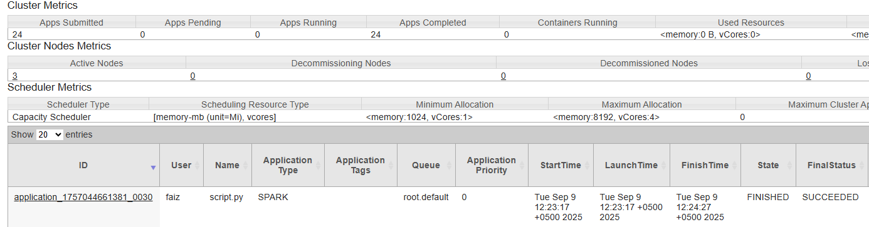
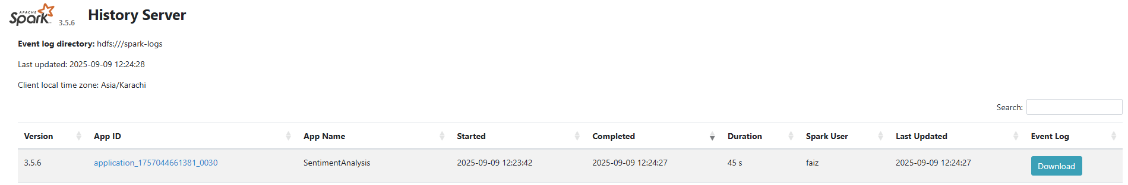
Dashboards
Yarn
Spark

Slide 7
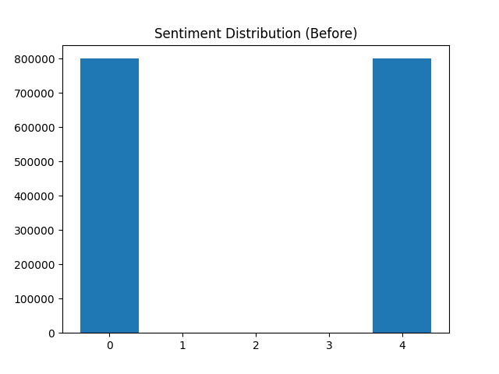
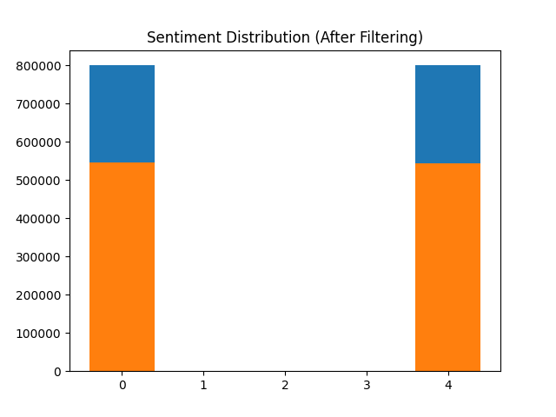
Graphs
Before Filtering
After Filtering

Slide 8


